Slide 1
Computer Vision Fundamentals
Lecture 4 - Part 1
Spatial Filtering

Slide 2
Contents
Spatial filtering
Filtering in MATLAB
Laplacian filter
Gaussian filter
Non-linear filters

Slide 3
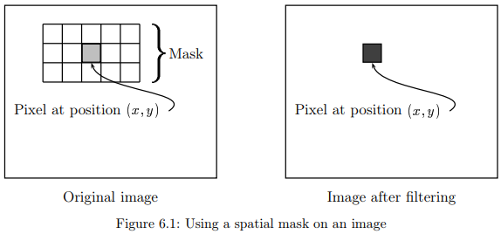
Spatial Filtering
We have seen that an image can be modified by applying a particular function to each pixel value.
Spatial filtering may be considered as an extension of this, where we apply a function to a neighbourhood of each pixel.

Slide 4
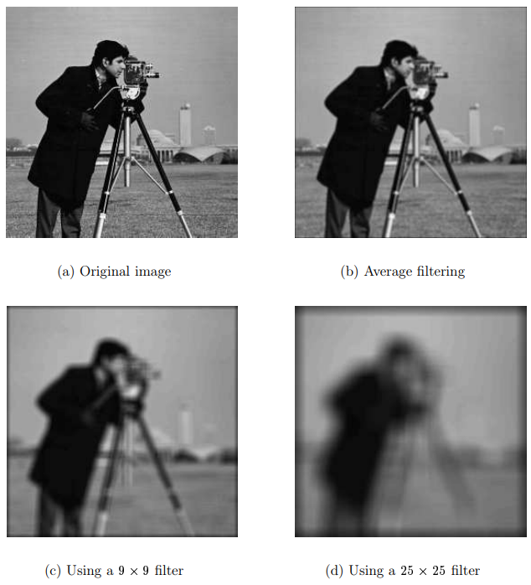
Filtering in MATLAB
>> c=imread(’cameraman.tif’);
>> f1=fspecial(’average’);
>> cf1=filter2(f1,c);
Or
>> figure,imshow(c)
>> figure,imshow(cf1/255)

Slide 5
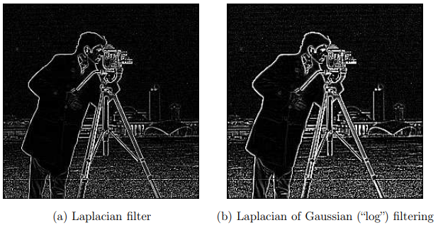
Laplacian Filter
>> f=fspecial(’laplacian’)
>> cf=filter2(f,c);
>> imshow(cf/100)
>> f1=fspecial(’log’)
>> cf1=filter2(f1,c);
>> figure,imshow(cf1/100)

Slide 6
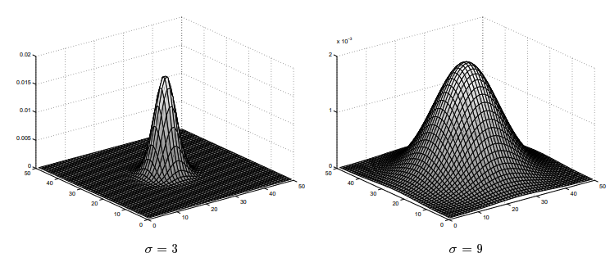
Gaussian Filter
Gaussian filters are a class of low-pass filter
The command fspecial(’gaussian’) produces a discrete version of this function

Slide 7
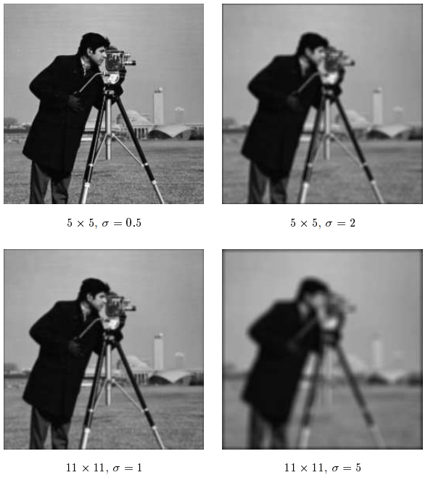
Non-linear filters
The function to use for non-linear is nlfilter, which applies a filter to an image according to a predefined function. If the function is not already defined, we have to create an m-file which defines it

Slide 8
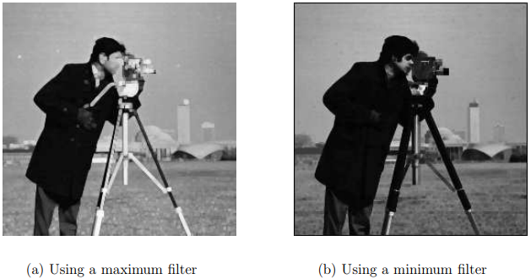
Cont.
A corresponding filter which takes the minimum value can be just as easily applied:
>> cmin=nlfilter(c,[3,3],’min(x(:))’);

Slide 9
Thankyou

